Slide 1
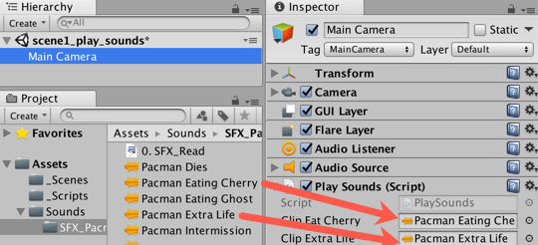
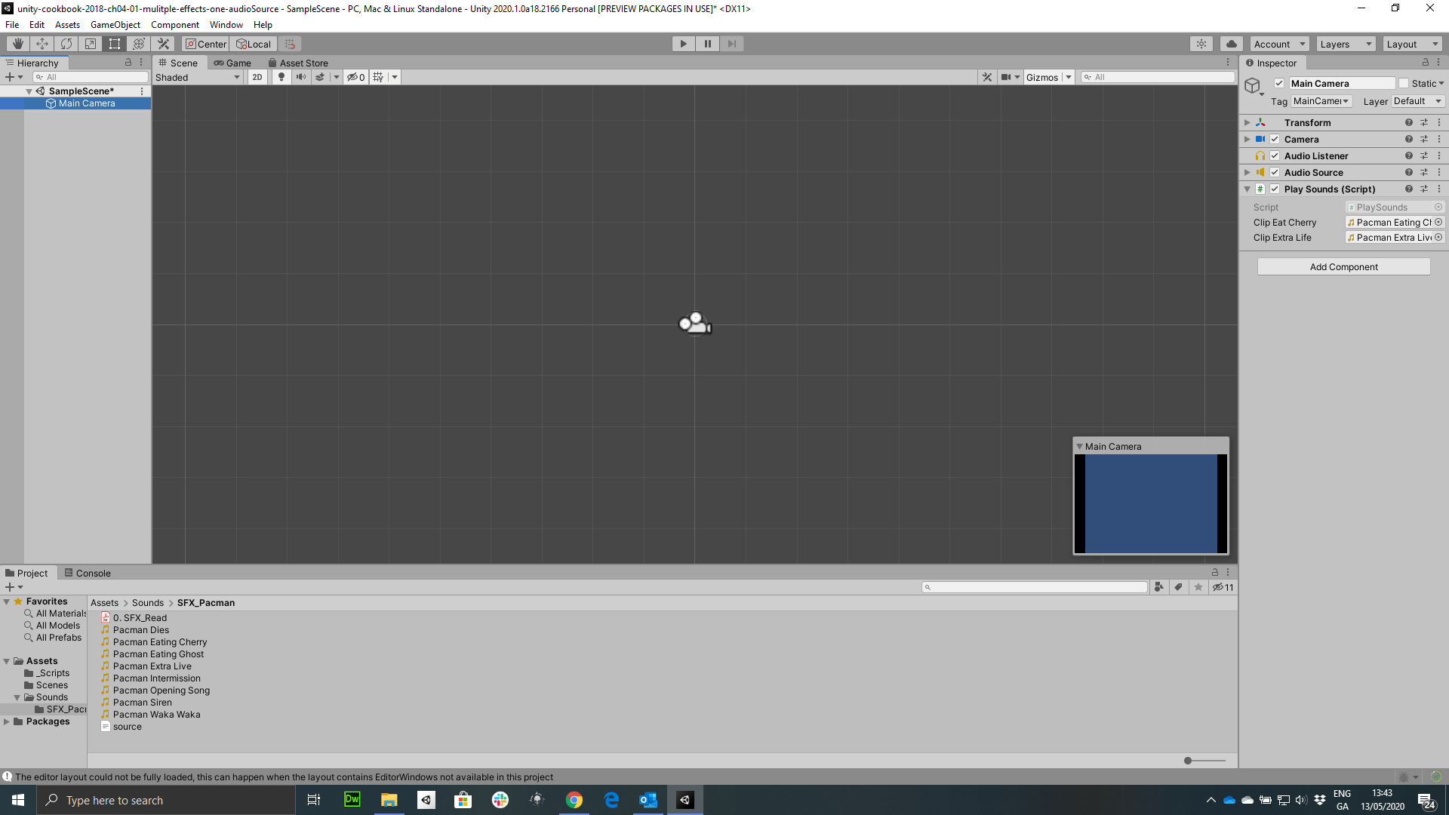
Figure 4.2: Dragging sound clips into the scripted component
Choose function-method
SceneLoader.LoadOnClick

Slide 2
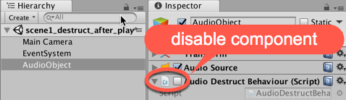
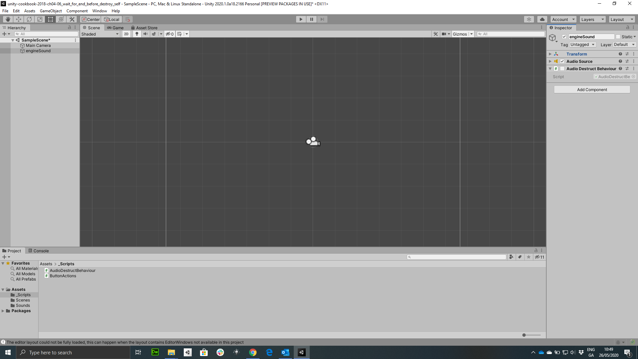
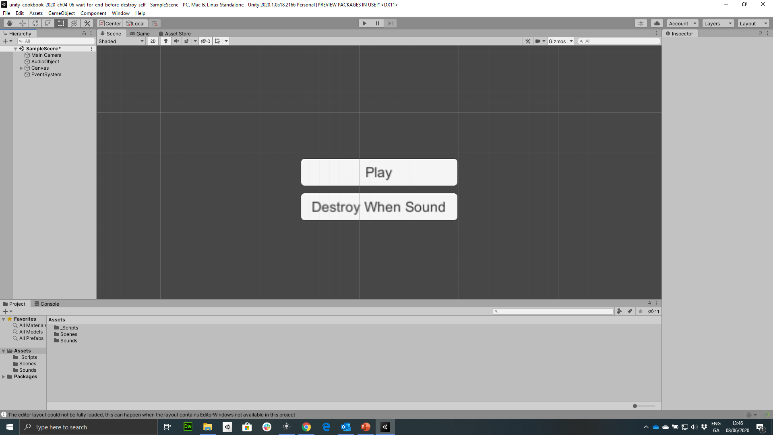
Figure 4.3: Disable (uncheck) the scripted component of AudioObject
disable component

Slide 3
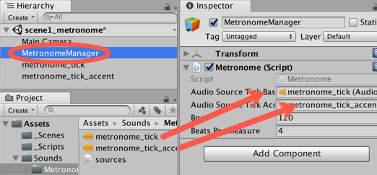
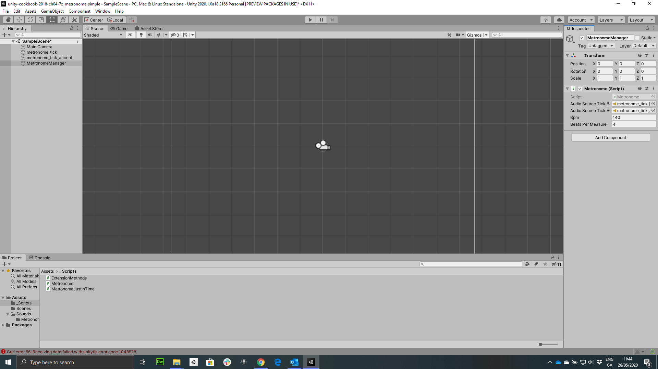
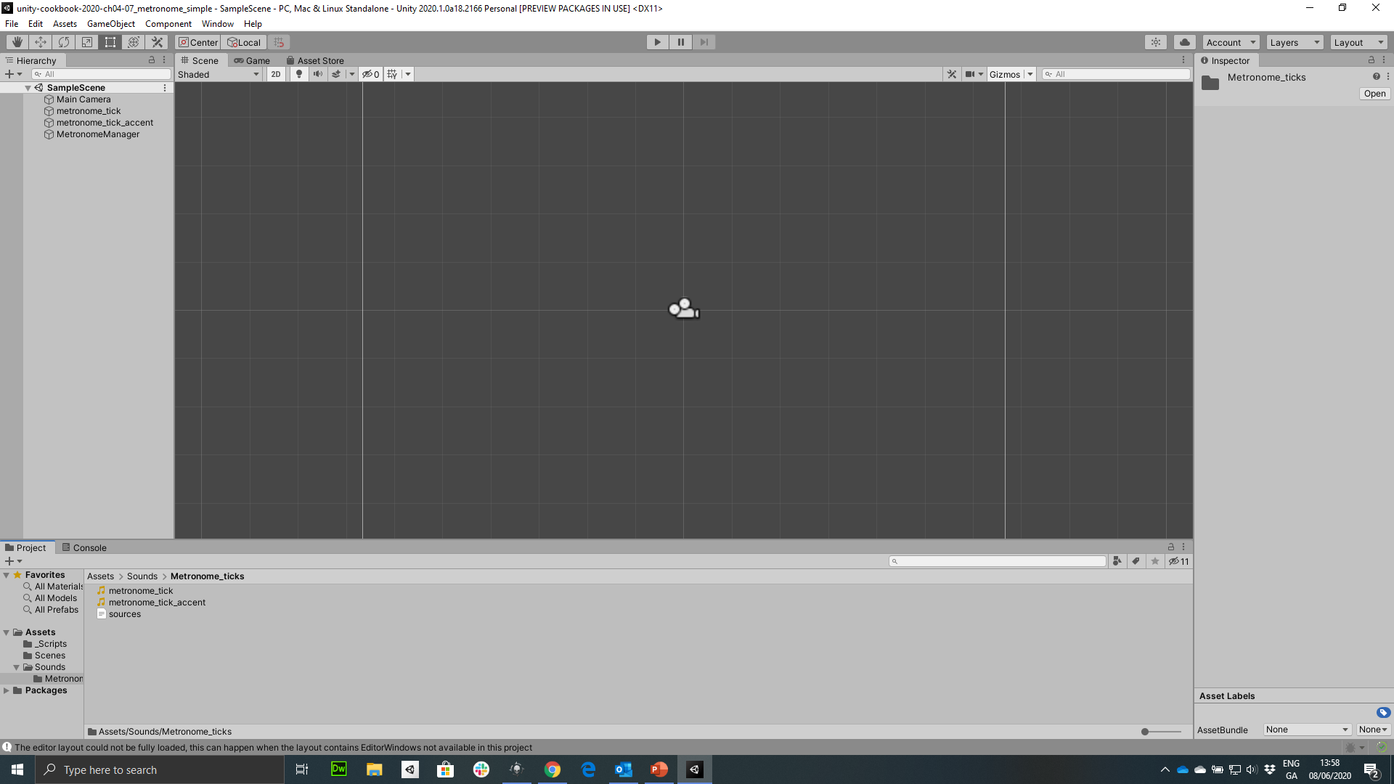
Figure 4.5: Dragging sound assets to Metronome (Script) component

Slide 4
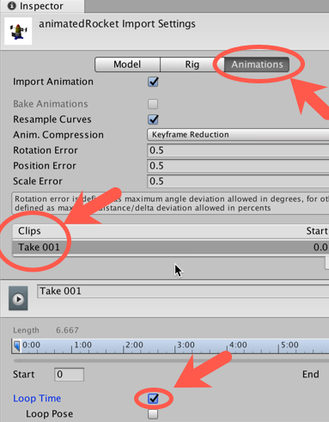
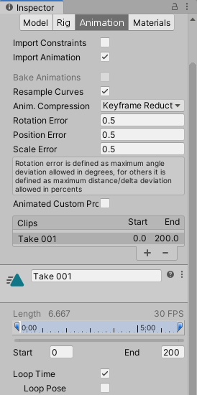
Figure 4.6: Animation settings for Take001 clip

Slide 5
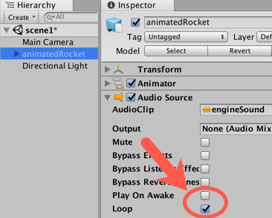
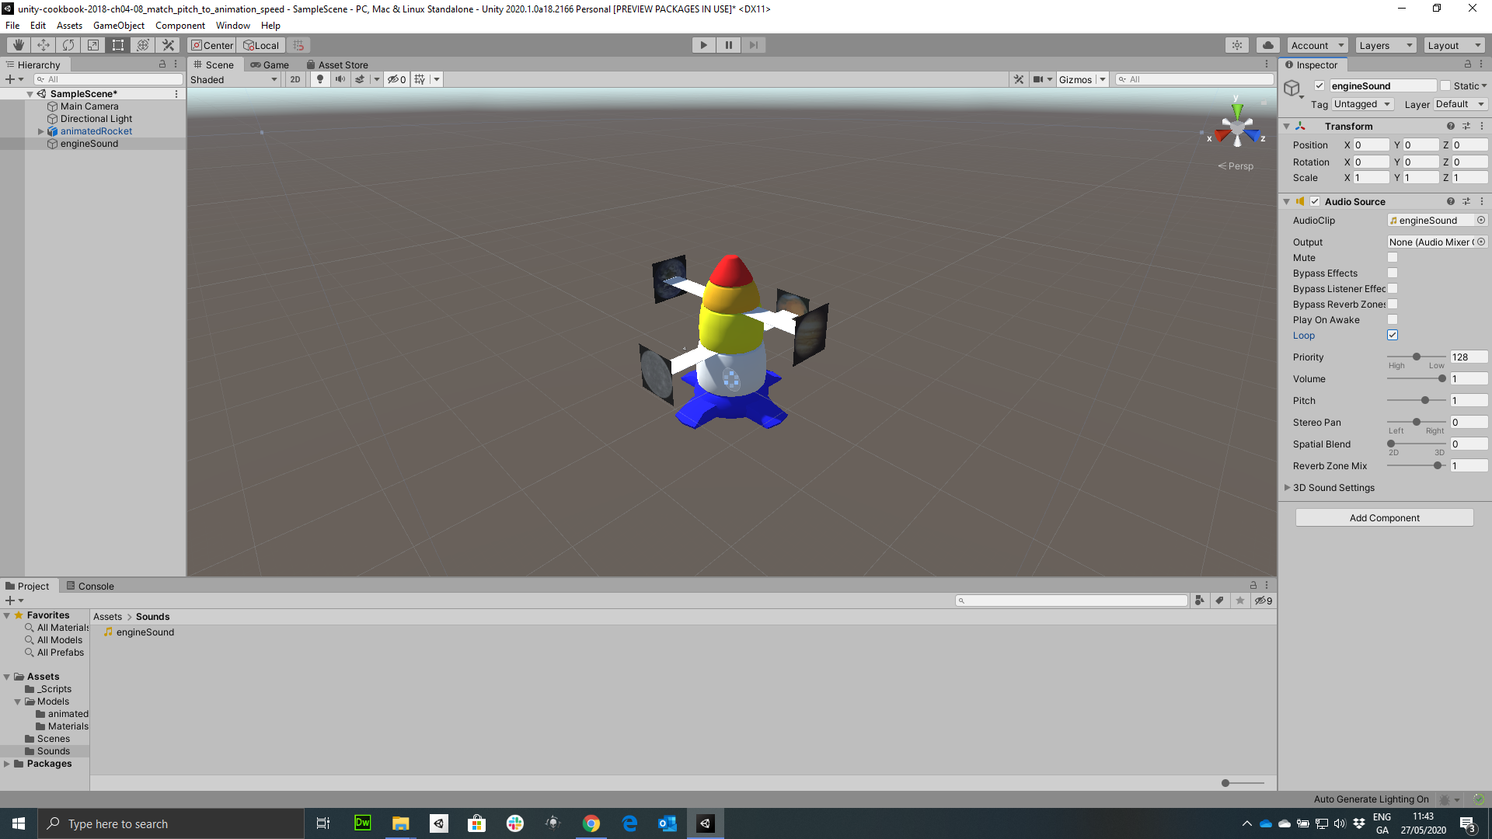
Figure 4.7: Loop and Play On Awake option settings

Slide 6
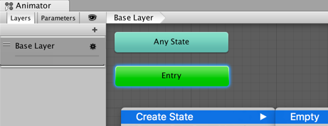
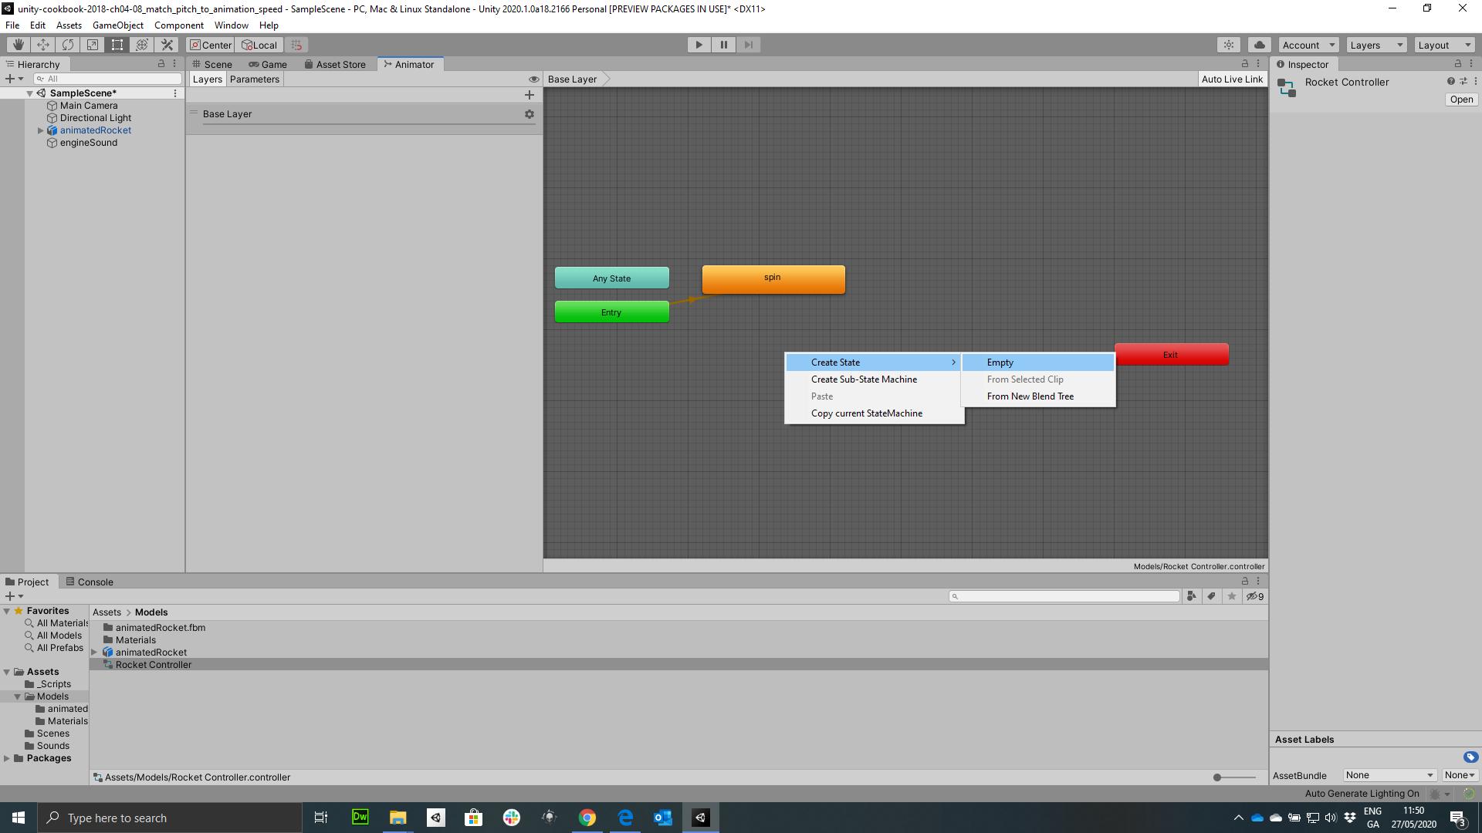
Figure 4.8: Creating a new animation state

Slide 7
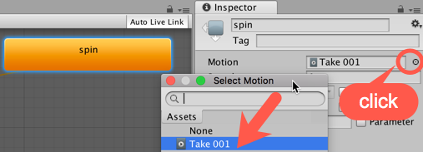
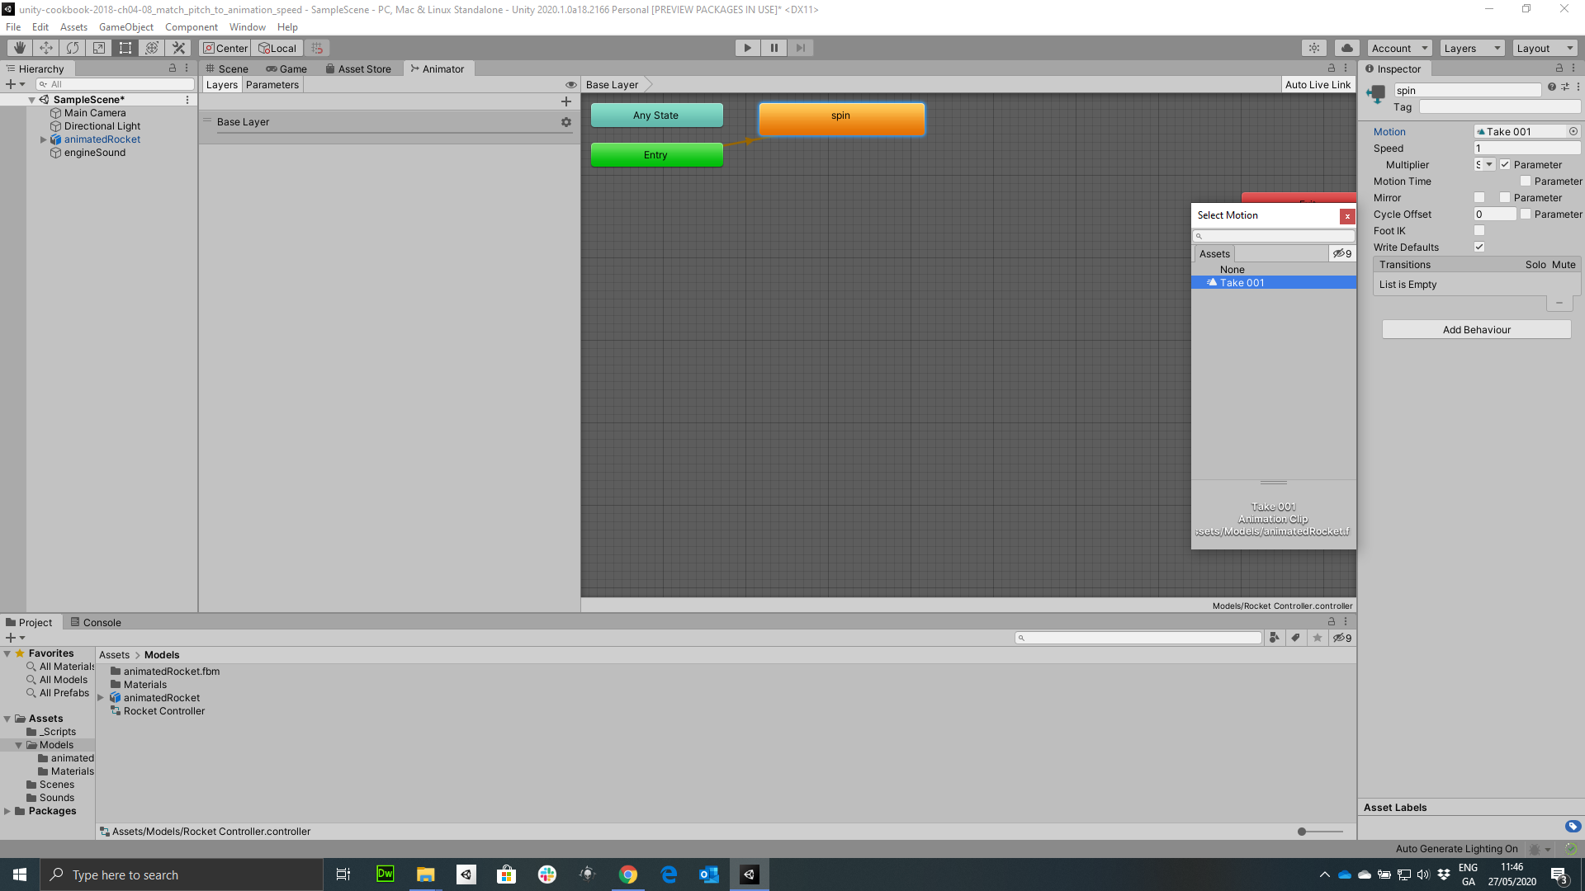
Figure 4.9: Renaming of animations state and setting its Motion field
click

Slide 8
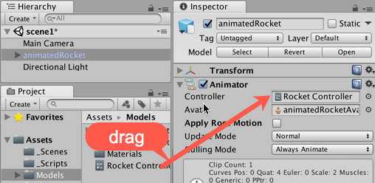

Figure 4.10: Drag the model into the Controller or the Animator component
drag

Slide 9
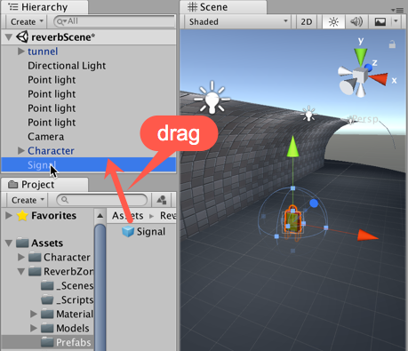
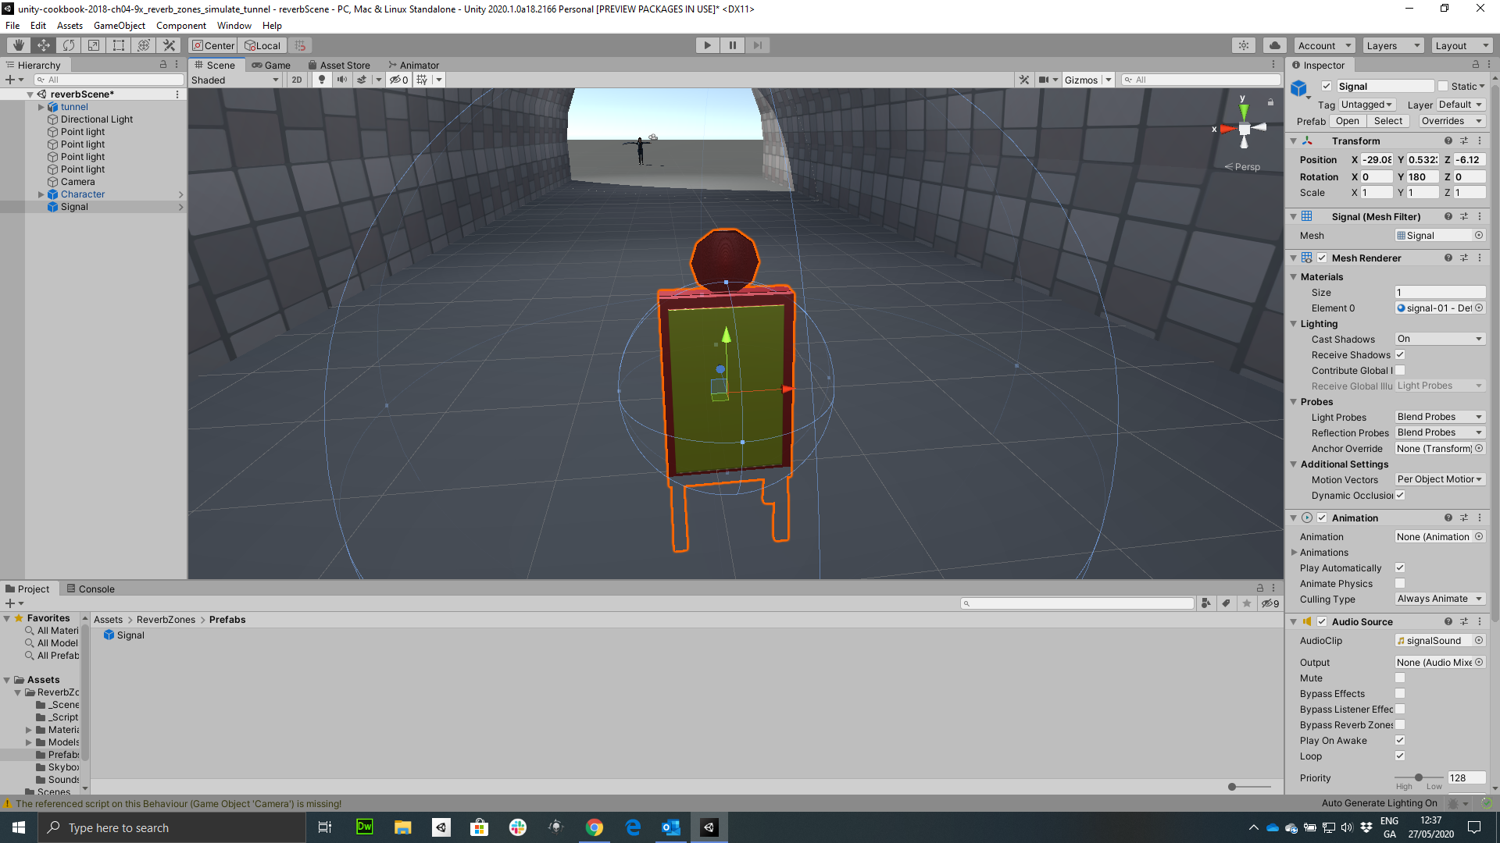
Figure 4.11: Dragging the Signal prefab into the Hierarchy
drag

Slide 10
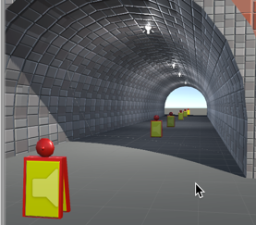
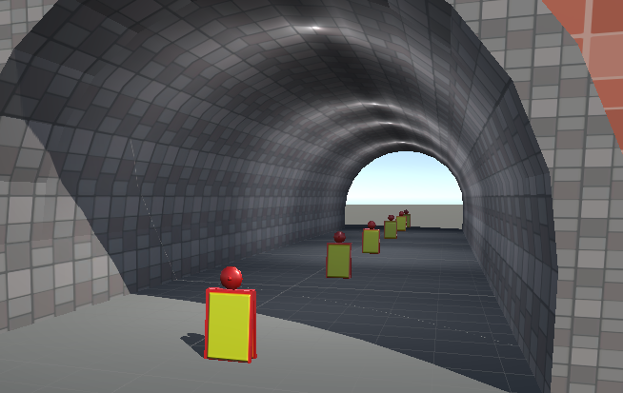
Figure 4.12: Distribution of five Signal GameObjects throughout the tunnel

Slide 11
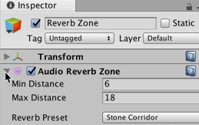
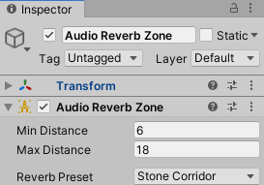
Figure 4.13: Audio Reverb Zone settings via the Inspector panel

Slide 12
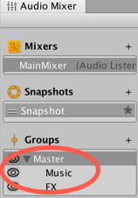
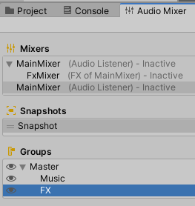
Figure 4.14: Audio Mixer panel

Slide 13
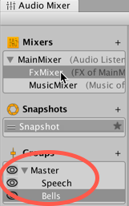
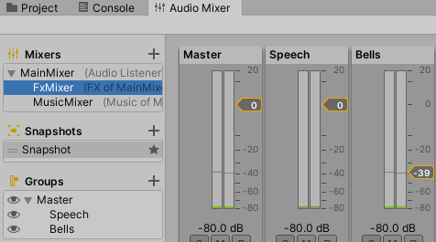
Figure 4.15: Adding two children to FxMixer - Speech & Bells

Slide 14
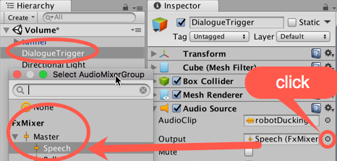
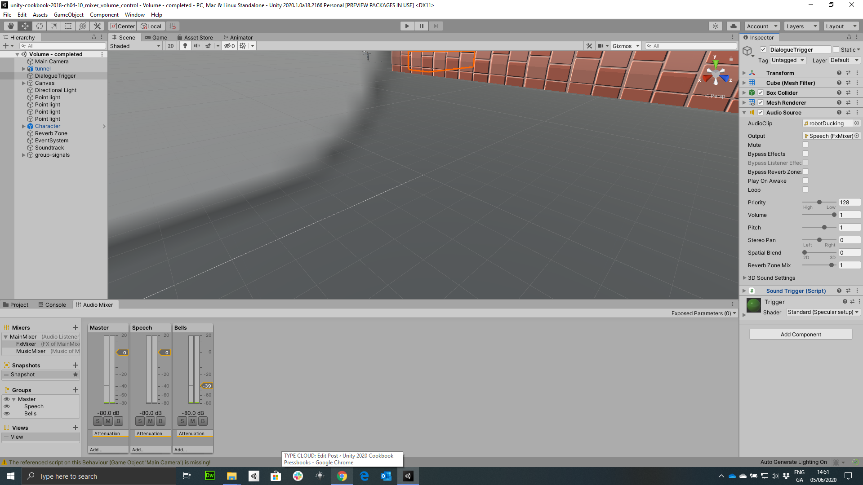
Figure 4.16: Settings for Audio Source
click

Slide 15
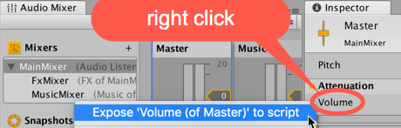
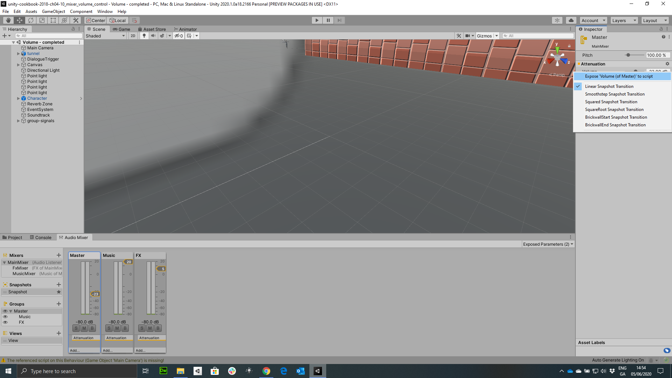
Figure 4.17: Selecting Expose Volume from the attenuation menu
Right click

Slide 16
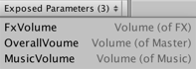
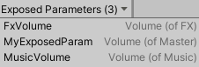
Figure 4.18: Exposed Parameters drop-down settings

Slide 17
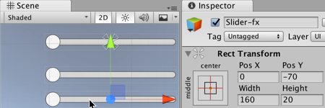
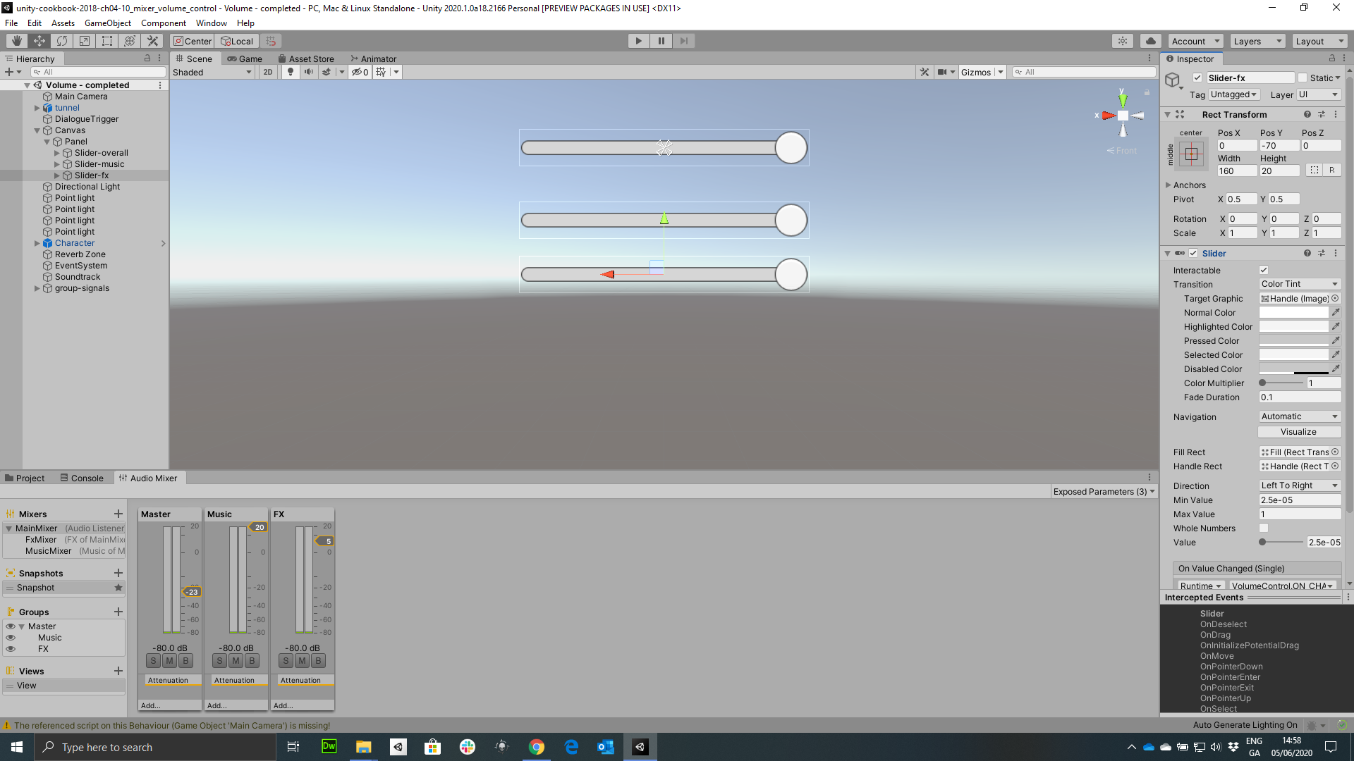
Figure 4.19: Slider-fx settings

Slide 18
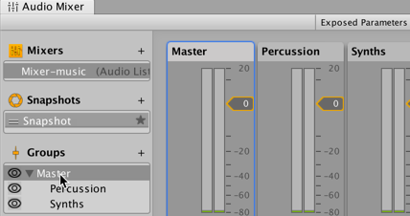
Figure 4.20: Adding childs to the Master group: Percussion & Synths

Slide 19
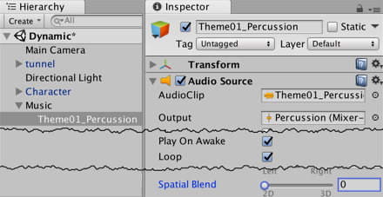
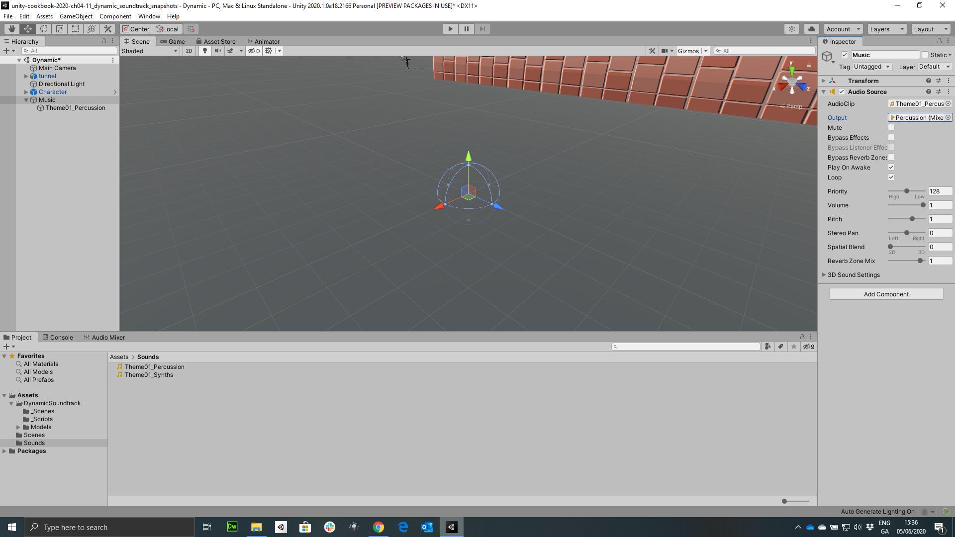
Figure 4.21: AudioSource settings for Theme01_Percussion

Slide 20
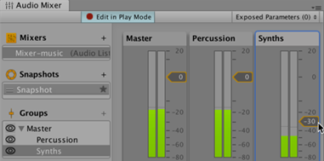
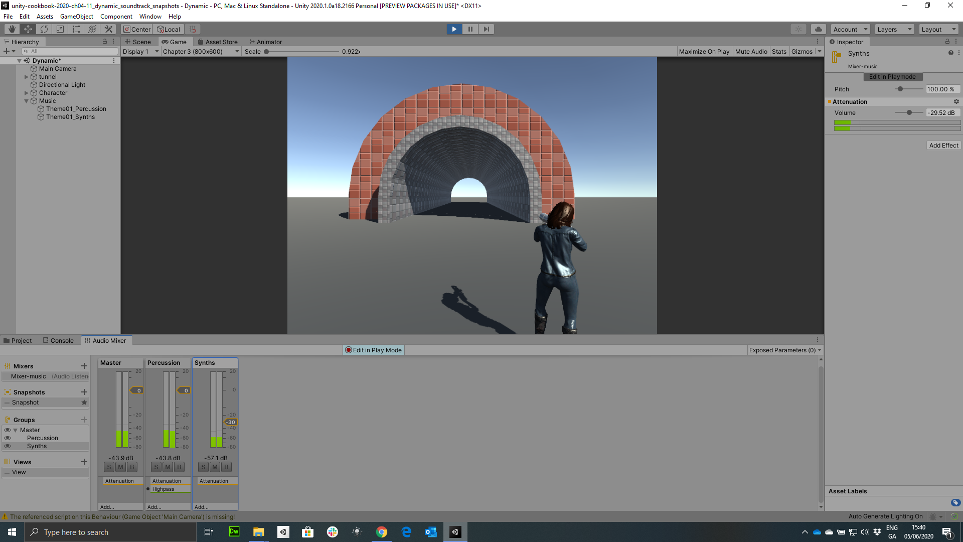
Figure 4.22: Editing the Audio Mixer in Play Mode

Slide 21
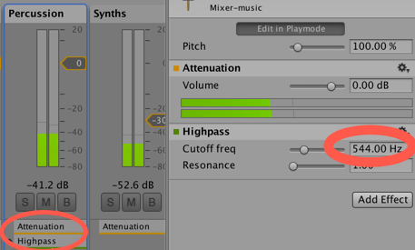
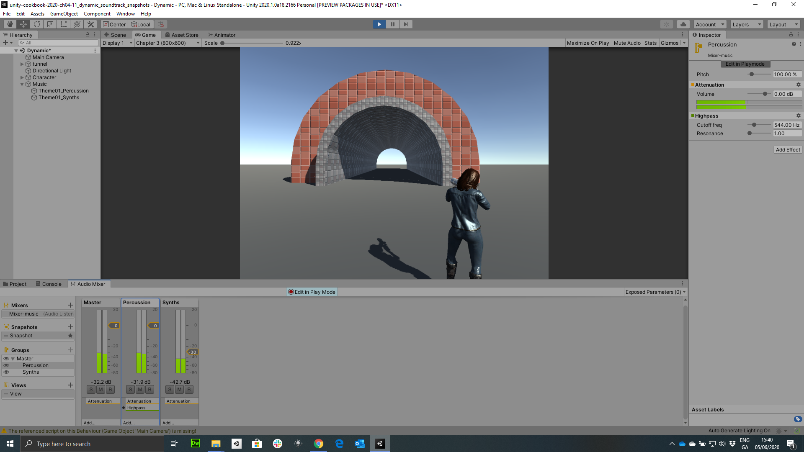
Figure 4.23: Adding the High-pass effect to the Percussion track

Slide 22
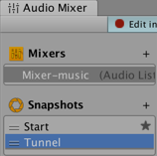

Figure 4.24: Create a new Snapshot for Tunnel

Slide 23
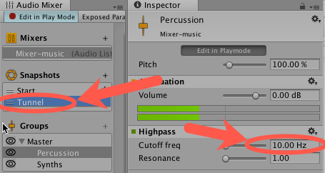

Figure 4.25: Settings for Tunnel snapshot

Slide 24
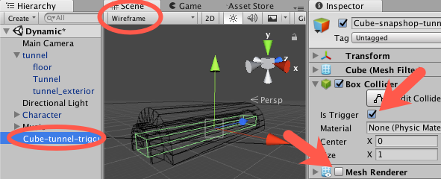
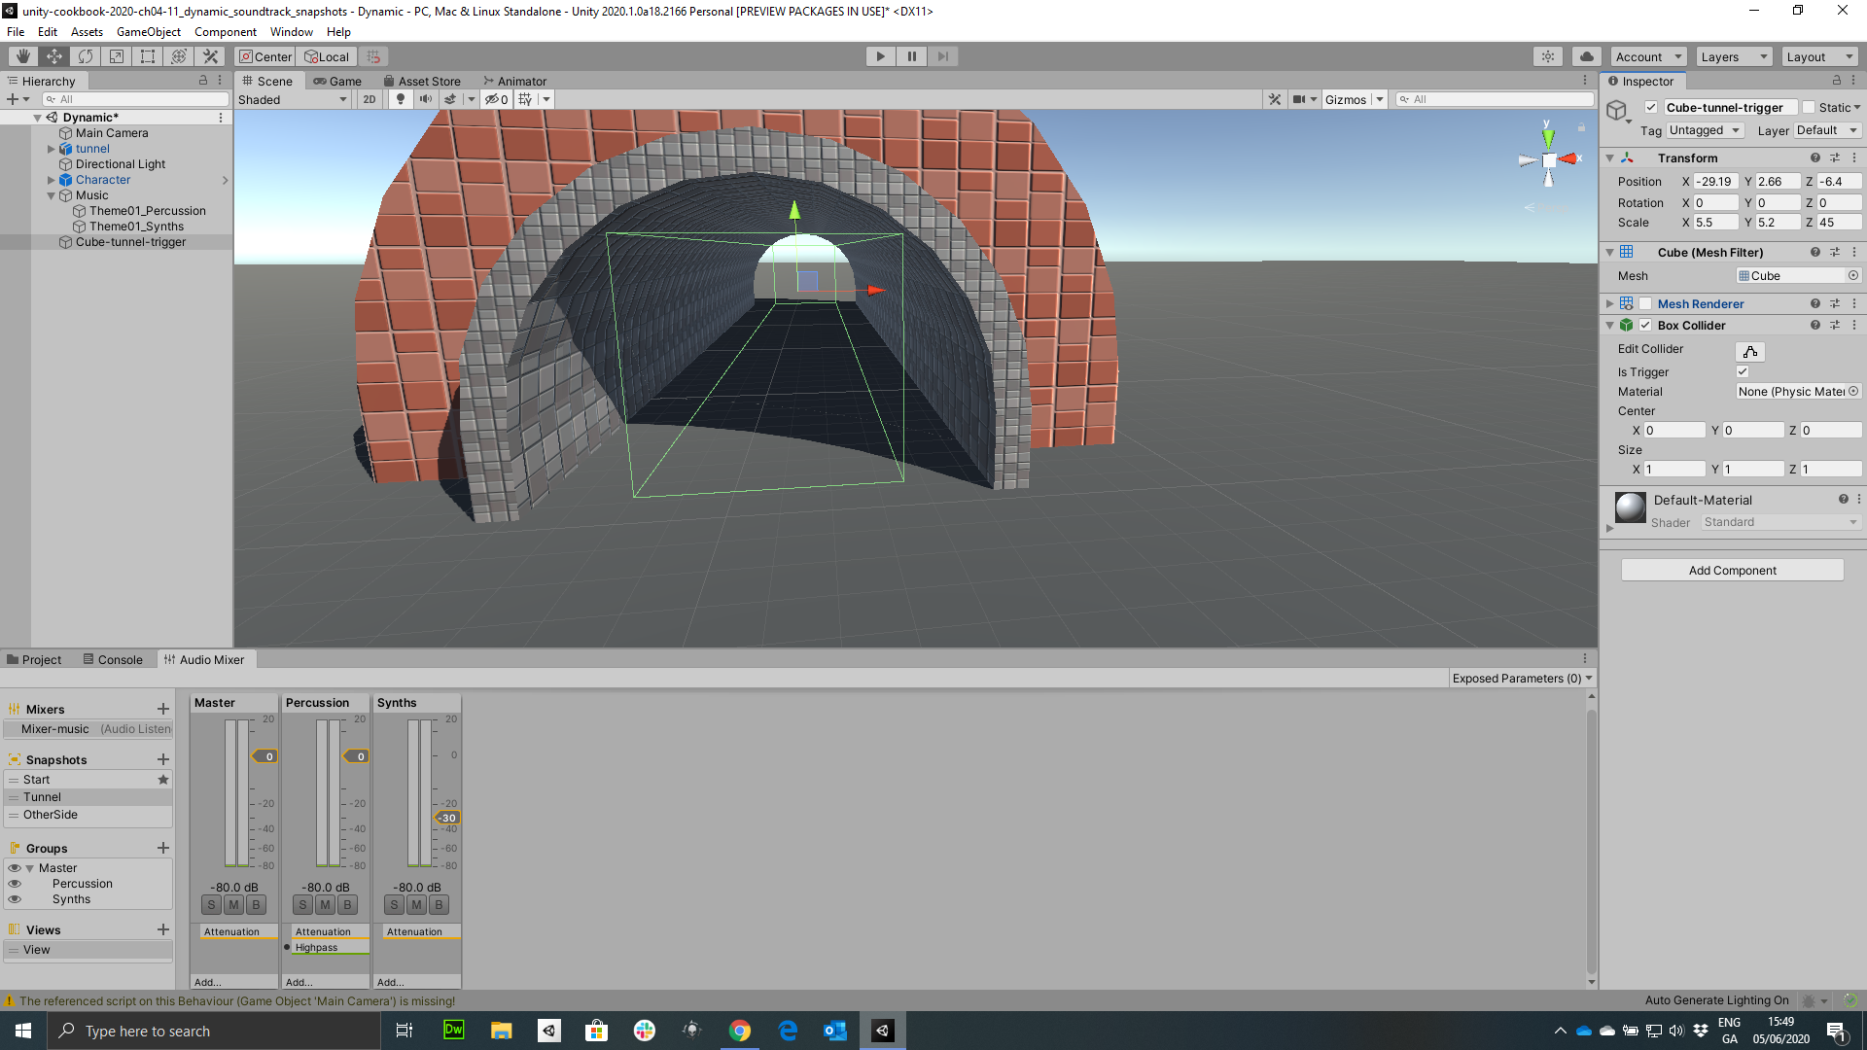
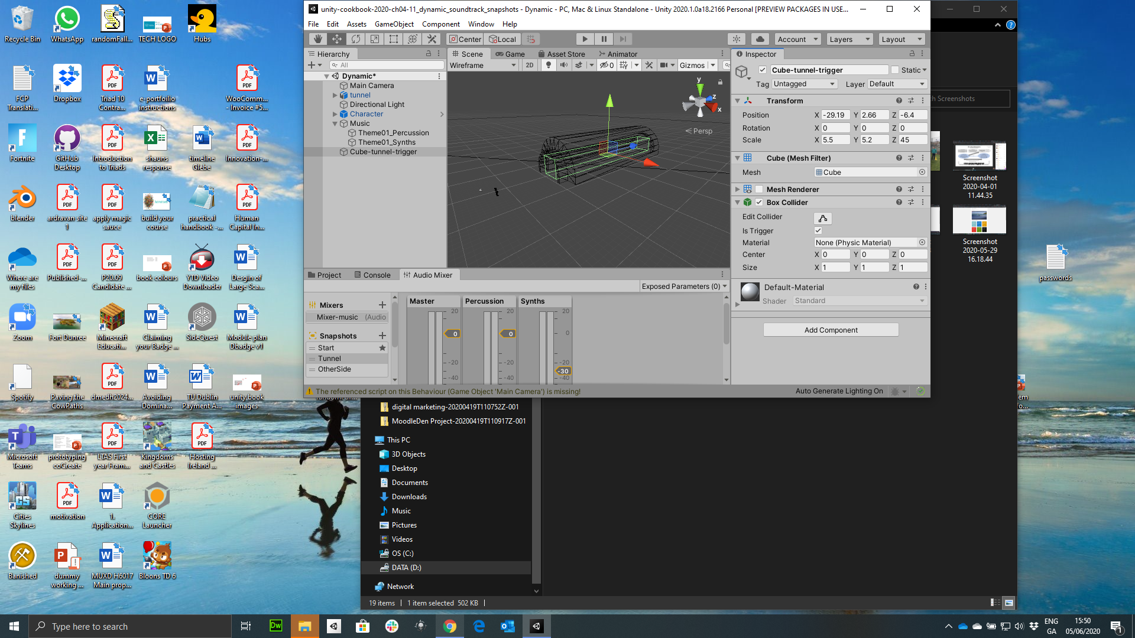
Figure 4.26: Wireframe view & setting for Cube-tunnel-trigger

Slide 25
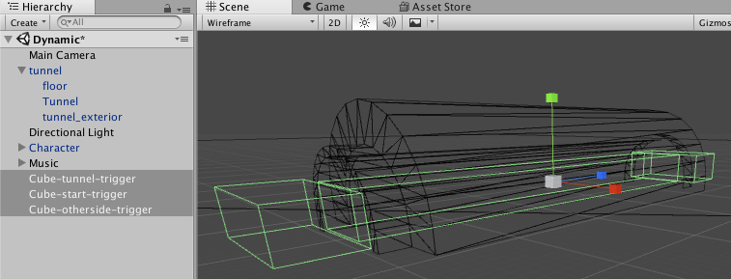
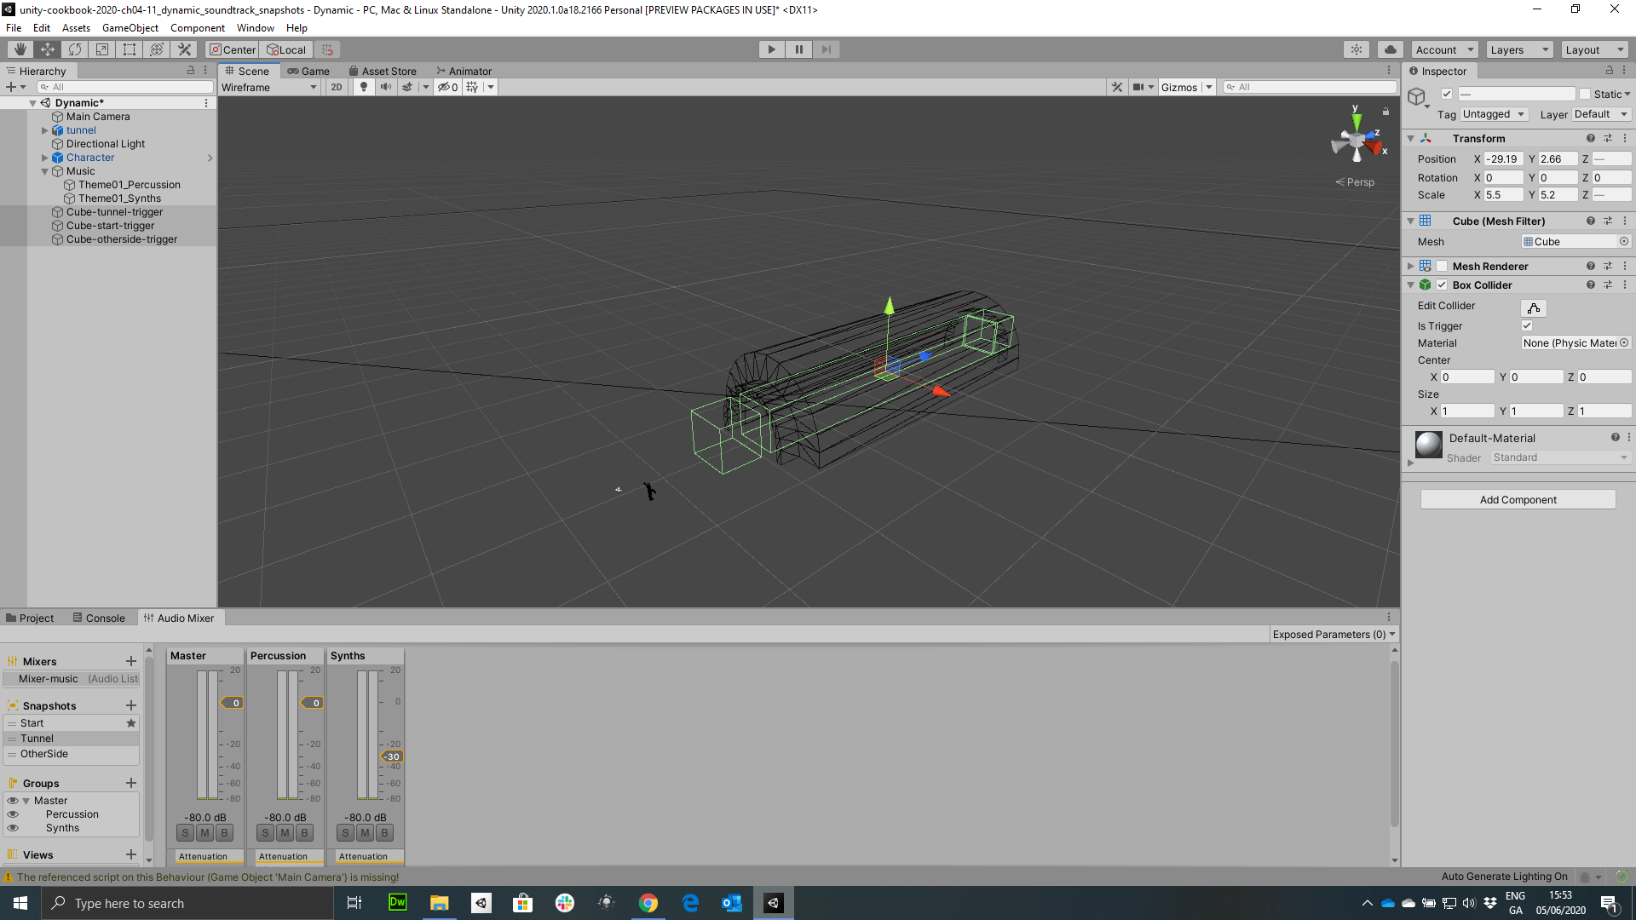
Figure 4.27: Adding triggers to the start and otherside of the Tunnel

Slide 26
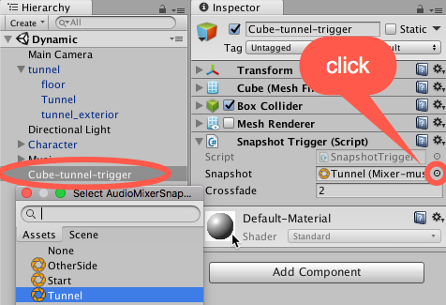

Figure 4.28: Settings for Snapshot Trigger (Script)
click

Slide 27


Figure 4.29: Add Music, FX, & Input as childs of the Master Group

Slide 28


Figure 4.30: Add FXMixer as a child of MainMIxer

Slide 29


Figure 4.31: Setting the Output track of the DialogueTrigger GameObject

Slide 30

Figure 4.32: Adding the Duck Volume effect to the Music track controller

Slide 31


Figure 4.33: Settings in Inspector view of Input track

Slide 32


Figure 4.34: Duck Volume settings on the Music track

Slide 33

Figure 4.35: Example of audio visualization recipe

Slide 34


Figure 4.37: Connecting each music loop GameObject to the AudioSources

Slide 35


Slide 36


Slide 37


Slide 38


